Slide 1

LHF Council Meeting
November 22, 2020

Slide 2
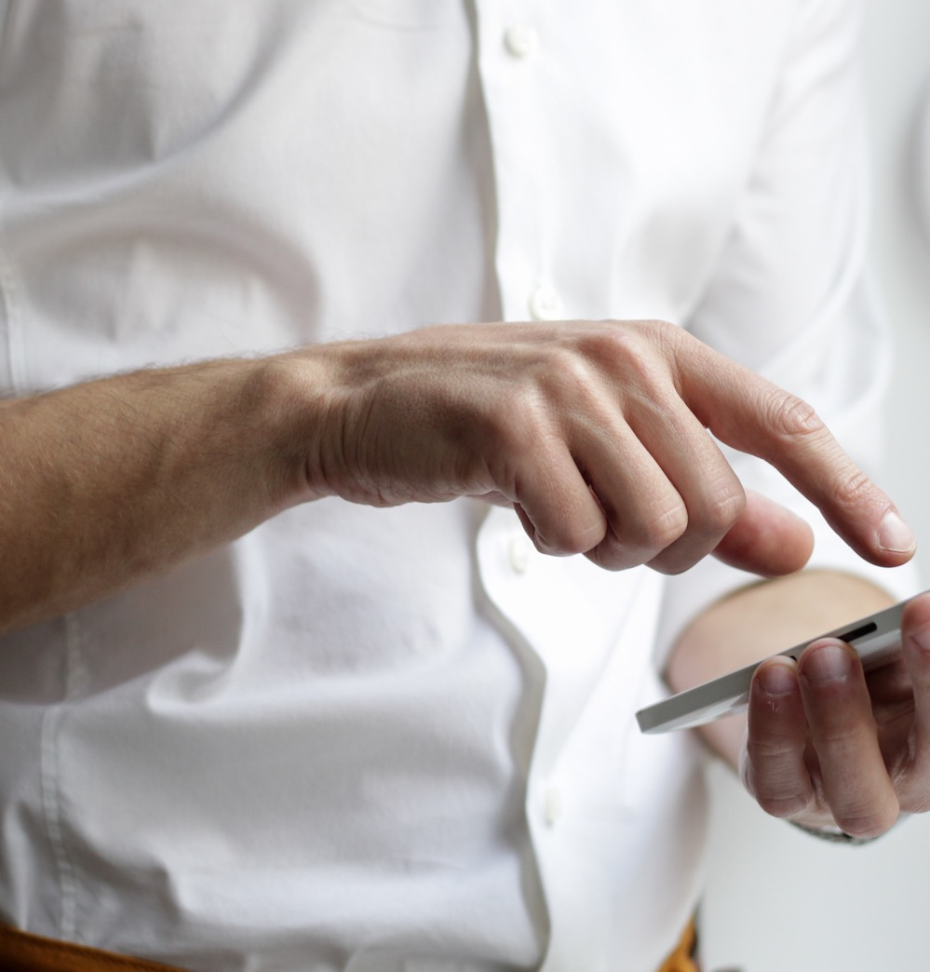
Welcome Parents
&
Introduction
Principal – Arin Otis
Vice-Principal – Angie Herdman
School Secretary – Rose Apa
Chair – Yana Peregudina
Parents Introduction: Name & Child(ren)’s grades

Slide 3

Agenda
Principal Report & School Updates
Treasurer Report
Information for the School Council Members
Fundraising
Ideas for Events & Special Requests & Inquiries
    PRO Grant
Special Events
  Holidays (Winter Season)
  Graduation (grade 8)
  Speakers
  Virtual Activities
Q & A
Next Meeting

Slide 4

Principal Report & School Updates
Staff Changes, administrative stuff (buses, safety procedures, etc.), Progress Reports Cards (November),
PA Days/Holiday Schedule, Special Events

Slide 5

Treasurer Report
Renata Solomon Lipovitch
Rose Apa

Slide 6
Information for the School Council Members:
Resources on the YRDSB website
Safety Protocols

Slide 7
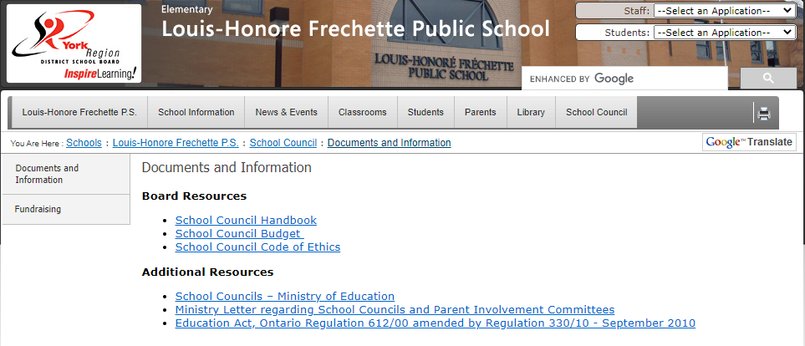
Information for the School Members
Agenda & Minutes:
YRDSB Website
Agenda – prior to the meeting (feel free to add any subjects & submit any questions, requests, or inquiries)
Minutes – after meeting (any suggestions are welcome at any time & subcommittees)
http://www.yrdsb.ca/schools/louishonorefrechette.ps/SchoolCouncil/Pages/Documents-and-Information.aspx
Safety Protocols
YRDSB Website
Weekly emails from Principal
Emails from YRDSB
School Updates

Slide 8
Fundraising

Slide 9
Fundraising
Last Year Fundraising
Fundraising Goals & Plan for 2021-2022
Technology for the school, gym, library, etc.
Used to do lunches (pizza)
Please share ideas (brainstorming)
Current Fundraising
Bottles
LHF Clothes

Slide 10
Ideas for Events & Special Requests and Inquiries
Do we need a survey for all parents?
PRO Grant

Slide 11
PRO Grant
https://www2.yrdsb.ca/schools-programs/school-councils/parents-reaching-out-pro-grants-school-councils
The Parent Reaching Out (PRO) Grants program provides funding ($800) to district school boards and school authorities to lead projects with a focus on the identification and removal of barriers that prevent parents and families from participating and engaging fully in their children's learning.
How schools can improve in at least one of the following areas:
  Addressing social inclusion and racism specifically anti-Asian, anti-Black, and anti-Indigenous racism and other prejudices toward racialized and marginalized groups
  Creating a safe and welcoming environment
  Demonstrating respect for parents as valued partners within the education system regarding decisions about their child’s education
  Enhancing communication with teachers
  Informing parents about the expectations of the Ontario Curriculum and supporting resources.
Outputs: Projects identify and address local barriers to parent engagement are implemented through a variety of means which may include but are not limited to:
  Parent resources
  Parent engagement sessions
  Parent information sessions
  Projects will reflect the diversity of our communities
Application deadline for submission is Tuesday, December 14, 2021

Slide 12
Special Events

Slide 13
Special Events
Holidays – Winter Season (ideas)
Other Events
Fairs & poems
Art & Craft (workshop cookie)
Fundraising (??)
Subcommittee
Guest speakers (PRO Grant)
Virtual Activities (yoga class, magic show, etc.)
Graduation (grade 8)
Last year: drive-thru
Requirements haven’t been issued yet for this year
Subcommittee
Photos

Slide 14
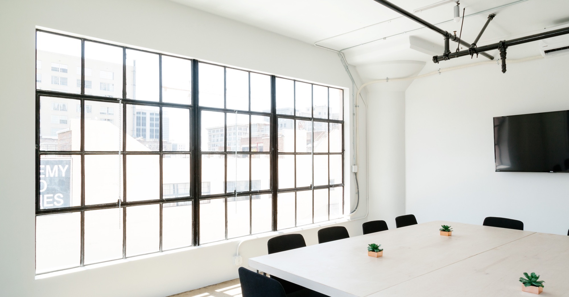
Large image
Questions & Answers

Slide 15




Thank You
Next Meeting: January, 2022
Yana Peregudina
+16479287447
Peregudina.yana@gmail.com

